Slide 1
Kashish Miglani -15BCE1003
Osho Agyeya -15BCE1326
Utsav Rai - 15bce1352
Analysis of research papers pertaining to Cellular Automata

Slide 2
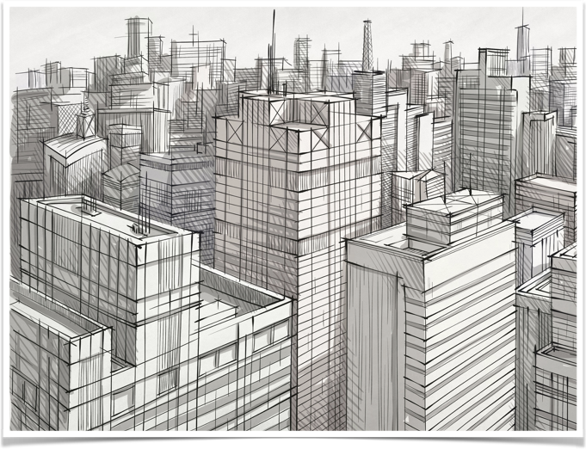
By KASHISH MIGLANI - (15BCE1003)

Slide 3
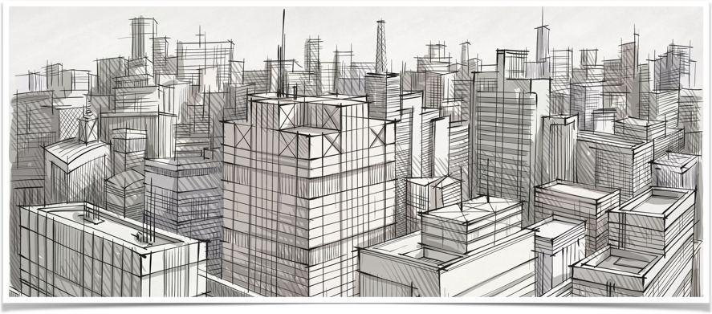
Analysis of research papers pertaining to Cellular Automata
“Epidemic Modelling using cellular automata”
by-Kashish Miglani (15BCE1003)

Slide 4
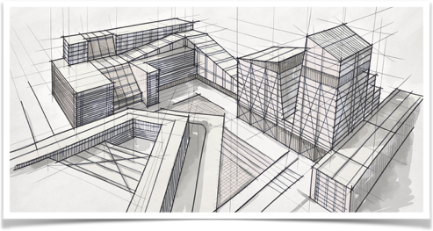
Abstract
The aim of this project is to view the impact of an epidemic over a region with uniform as well as non-uniform population densities.
here, We will be using the property of cell evolution in cellular automaton.
This will further help us to predict the flow of an outbreak.

Slide 5
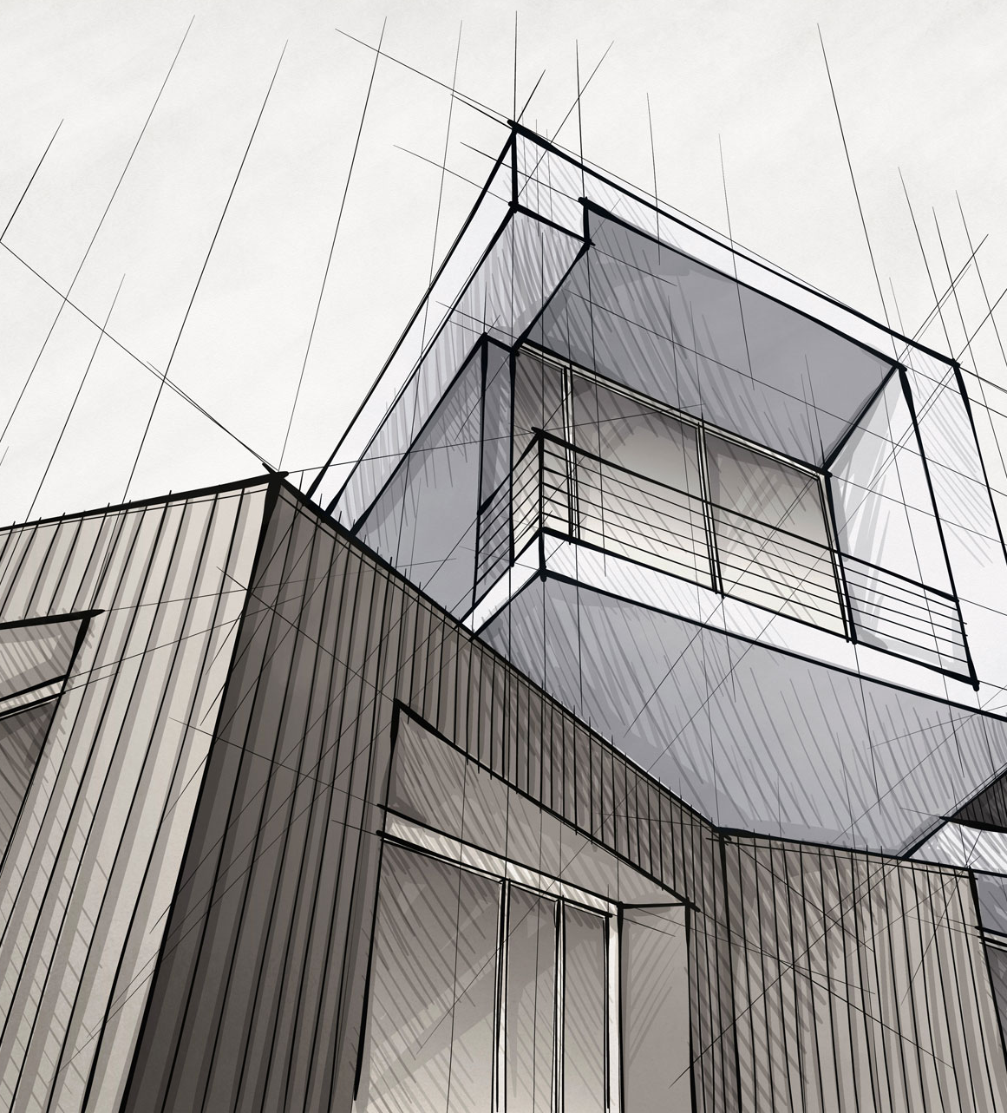
Problem Definition
“Epidemic Modelling Using Cellular Automata”
To understand how the disease is spread across a region.
To visualise it with the help of CELLULAR AUTOMATA.
To study the variation in model with movement of population and many other real-time factors.
Finally, to implement a Dynamic cellular automata model for non-homogenous as well as homogenous population distribution.

Slide 6
Issue Motivated
“Public Health Issues”
Since public health issues are one of the major concern and most of them occur by the virus spread.
This results in various problems such as decreased worker productivity etc.For example “The Severe Acute Respiratory Syndrome Outbreak in Asia”.
Therefore the monitoring of outbreaks is gaining importance for public health officials and the Government.
Hence it is desirable to predict patterns of viral infections given certain environmental conditions.
It is hoped that modelling geographically dependent features of a phenomenon will help us better UNDERSTAND , PREDICT and CONTROL that phenomenon’s behaviour.

Slide 7

Literature Survey
Research Paper Name | EPIDEMIOLOGY THROUGH CELLULAR AUTOMATA Case of Study: Avian Influenza in Indonesia | Using Cellular Automata to Simulate Epidemic Diseases | Dynamic Cellular Automata Based Epidemic Spread Model for Population in Patches with Movement | Epidemiological cellular automata: A case study involving AIDS | Parameter Scaling for Epidemic Size in a Spatial Epidemic Model with Mobile Individuals
Name of the Author | Hokky Situngkir | S. Hoya White A. Mart´ın del Rey G. Rodr´ıguez S´anchez | Senthil Athithan Vidya Prasad Shukla Sangappa R. Biradar | Prof. Ajit Narayanan | Chiyori T. Urabe Gouhei Tanaka Kazuyuki Aihara Masayasu Mimura
Transaction name/Journal name | Working Paper WPF2004, Bandung Fe Institute | Applied Mathematical Sciences, Vol. 3, 2009, no. 20, 959 - 968 | Journal of Computational Environmental Sciences Volume 2014 (2014), Article ID 518053 | Auckland University of Technology | Institute of Industrial Science, The University of Tokyo, Tokyo, Japan
Email of the Author | hokky@elka.ee.itb.ac.id | sarahw@usal.es delrey@usal.es gerardo@usal.es | Not Available | Not Available | chiyori@iis.u-tokyo.ac.jp
Date of Publishing | January 29, 2004 | 2009 | 12 February, 2014 | June 2013 | December 14, 2016

Slide 8
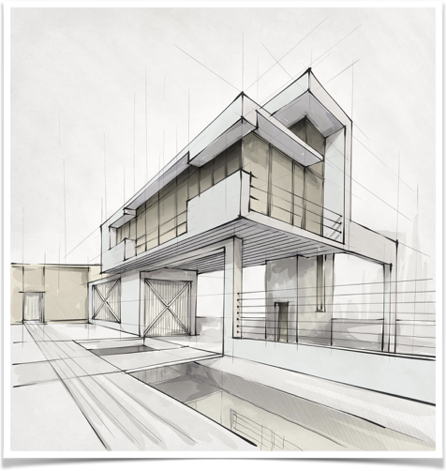
List of modules
Reading the chosen Research Papers , Research Articles , Case studies.
Trying to implement Cellular automata model for Epidemiology
Analysing various changes in model with change in various population characteristics.

Slide 9

Conclusion
“A Quick Brief”
Cellular Automata
Cellular automata are discrete dynamical systems that model complex behaviour based on simple, local rules animating cells on a lattice. They epitomise the idea that simple rules can generate complex patterns.
It consists of an array of cells with each state being represented by integer. In simplest forms of Cellular Automata , space is represented by a uniform M- dimensional grid of cells with each cell containing some data.
The cell state changes on the basis of the UPDATE RULE . This rule is basically a function which defines the cell state after a step time and it takes the cell’s current state and the state of the K-neighbouring cells.
Possible neighbourhoods for 2D Cellular Automata are
Von Neumann Neighbourhood - Each cell will have neighbour at it’s each face,
Moore Neighbourhood - it consists of Neumann’s neighbours plus cells at the 4 corners of a cell.

Slide 10
“Epidemic Modelling Using Cellular Automata”
15BCE1003
Epidemic Modelling
When there is a sudden increase of a disease in a particular time and space , it is referred to as Outbreak.
When Outbreak reaches many times the Endemic level ,it’s classified as Epidemic.
Here a cell represents an equal sized area of landscape containing a specific population . Different cells will have different populations with different densities and different mobility properties.
Initially we are assuming that population distribution is homogenous , so on the basis of certain conditions we will be deciding the state of the cell.One possible condition can be -
Cell State=(infected population of (a, b)) / (total population of (a, b))
On the basis of this rule states of a all the cells will keep on changing at every time step.

Slide 11
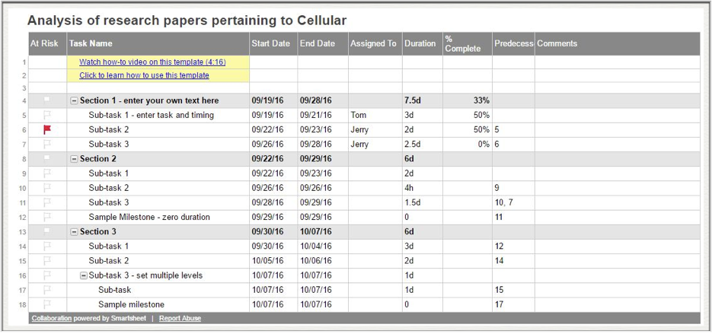
Gantt Chart

Slide 12
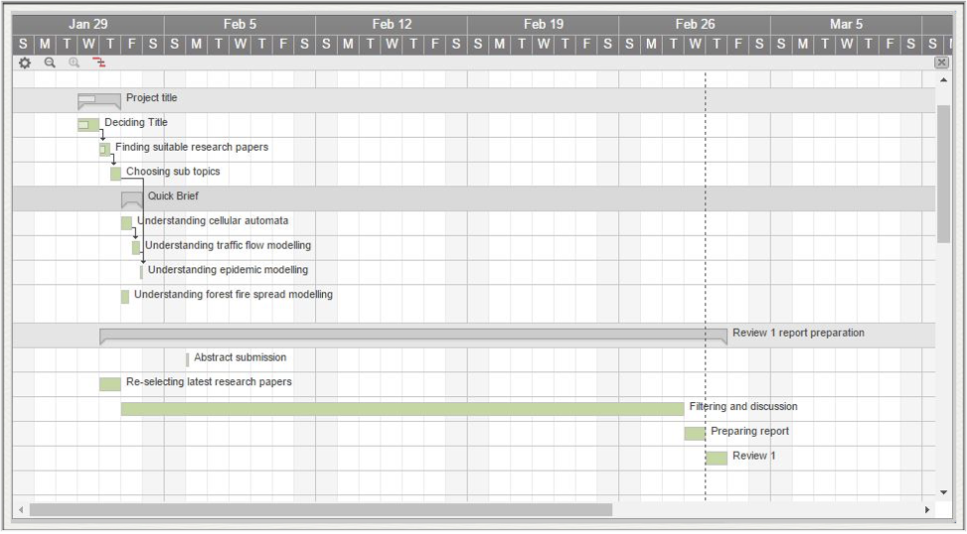

Slide 13
References
EPIDEMIOLOGY THROUGH CELLULAR AUTOMATACase of Study: Avian Influenza in Indonesia *), http://cogprints.org/3500/1/Aflu.pdf
Using Cellular Automata to Simulate Epidemic Diseases, http://www.m-hikari.com/ams/ams-password-2009/ams-password17-20-2009/delreyAMS17-20-2009.pdf
Dynamic Cellular Automata Based Epidemic Spread Model for Population in Patches with Movement, http://dx.doi.org/10.1155/2014/518053
Parameter Scaling for Epidemic Size in a Spatial Epidemic Model with Mobile Individuals, http://dx.doi.org/10.1371/journal.pone.0168127
Epidemiological cellular automata: A case study involving AIDS , http://aut.researchgateway.ac.nz/bitstream/handle/10292/7374/ApentengOO.pdf?sequence=3

Slide 14
By kashish Miglani - (15BCE1003)

